Slide 1
HR WORKFORCE AND
PERFORMANCE ANALYSIS
PROJECT REPORT BY SOMENATH SAU
Detailed Business Intelligence Report
Workforce composition | Compensation | Performance | HR priorities
01 Workforce
02 Compensation
03 Performance
04 HR Insight
Who is in the workforce?
How is pay distributed?
How are employees performing?
Where should HR focus?
Analysis of a 10,000-employee workforce dataset
HR Workforce And Performance Analysis • Somenath Sau
1

Slide 2
OVERVIEW
Executive Summary
The report combines descriptive workforce analysis with practical HR questions
10,000
8,488
1,512
3.8 / 5
₹75,550
Total employees
Active employees
Inactive employees
Average performance
Average gross salary
What the report covers
How to read the findings
Four Power BI pages explore employee profile, pay patterns, performance ratings, and a defined high-value employee segment.
Results are descriptive. Patterns show where to investigate; they do not prove causes, fairness, or future employee behaviour.
Executive messages
The dataset contains 10,000 employee records, with 84.88% marked active and 15.12% inactive.
Average gross salary is ₹75,550, but the salary mix varies considerably across job roles.
Average performance is 3.8 out of 5; role averages shown are tightly clustered around the high 3s.
The analysis identifies 2,522 employees meeting the defined high-value criteria for focused HR review.
HR Workforce And Performance Analysis • Somenath Sau
2

Slide 3
PROJECT FRAMING
Business Objective & Analytical Questions
The report is organized around decisions a people or HR team may need to make
Workforce planning
Compensation review
Performance review
What is the workforce size and active status? How are employees distributed by role, department, qualification, gender, and hiring month?
How do average salaries differ by department and role? How does experience relate to gross salary? How much bonus is paid on average?
How do ratings vary by department and role? What does the rating distribution look like? How does salary relate to ratings?
Core analytical questions
Intended audience
• Which departments and roles account for the largest employee counts?
• Are hiring volumes consistent across months or do they show peaks and dips?
• Which job roles have the highest and lowest average salary in this dataset?
• Do higher salary values consistently align with higher performance ratings?
• Which departments and roles contain the largest counts of employees meeting the project's high-value definition?
HR analysts, people managers, and business stakeholders who need a concise view of workforce structure, compensation, performance, and areas for further investigation.
HR Workforce And Performance Analysis • Somenath Sau
3

Slide 4
METHOD
Data Validation & Preparation Methodology
Dataset checks performed
1. Completeness
All datasets were checked for row counts, data types, missing values, and duplicate rows.
2. Key integrity
Employee IDs match across emp_info and emp_salary; department and role IDs match their dimension tables.
Validation results from the four supplied CSV files
3. Date and rating checks
DOB and hire_date parse successfully using day-first dates; performance ratings range from 1.5 to 5.0.
4. Numeric checks
Salary and deduction fields contain no missing values or negative amounts; experience ranges from 0 to 12 years.
5. Model structure
The model uses emp_info, emp_salary, department, and job_roles linked by employee, department, and role IDs.
HR Workforce And Performance Analysis • Somenath Sau
4

Slide 5
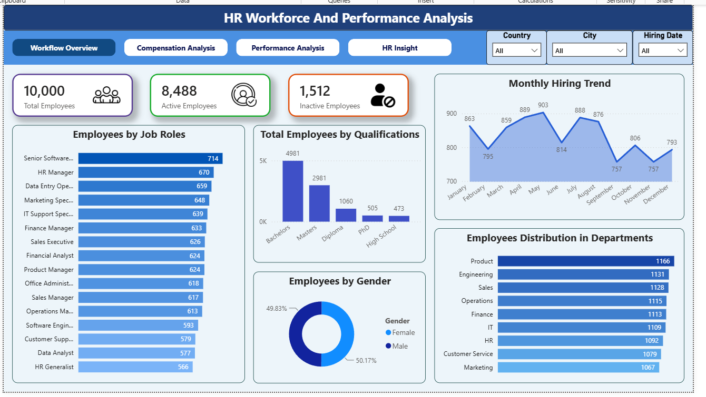
DASHBOARD REVIEW
Workforce Overview
Who is represented in the dataset and how is the workforce distributed?
Key observations
• Total employees: 10,000; 8,488 are active and 1,512 are inactive.
• Active employees represent 84.88% of the dataset; inactive employees represent 15.12%.
• Product is the largest department by headcount (1,166), followed by Engineering (1,131) and Sales (1,128).
• Bachelor's qualification is the largest category shown (4,981), followed by Master's (2,981).
• Gender distribution is nearly balanced: Female 50.17% and Male 49.83%.
• Monthly hiring ranges from 757 to 903 in the displayed chart.
INTERPRETATION
The report provides a baseline for headcount, composition, and hiring patterns. Monthly variation is visible, but the chart alone does not explain why it occurs.
HR Workforce And Performance Analysis • Somenath Sau
5

Slide 6
FINDINGS
Workforce Overview - Interpretation
Translate descriptive charts into questions for workforce planning
Headcount distribution
Hiring trend
Employee status
Product has the highest employee count in the shown department chart. This may reflect the dataset's organizational design, not necessarily a staffing surplus.
Monthly hiring varies. Review recruiting demand, hiring plans, seasonality, and data completeness before interpreting peaks as business events.
1,512 employees are marked inactive. The status definition and timing should be confirmed before treating this as attrition or turnover.
Follow-up questions
Potential action
• Does inactive status mean terminated, resigned, retired, on leave, or another status?
• Are monthly hiring values based on hire date and counted consistently across all months?
• Do the largest departments also have the highest workload, service demand, or business contribution?
• How do role and qualification distributions compare with workforce plans?
Use headcount and hiring trends as a planning baseline, then compare them with approved staffing plans, open requisitions, workload, and budget.
HR Workforce And Performance Analysis • Somenath Sau
6

Slide 7
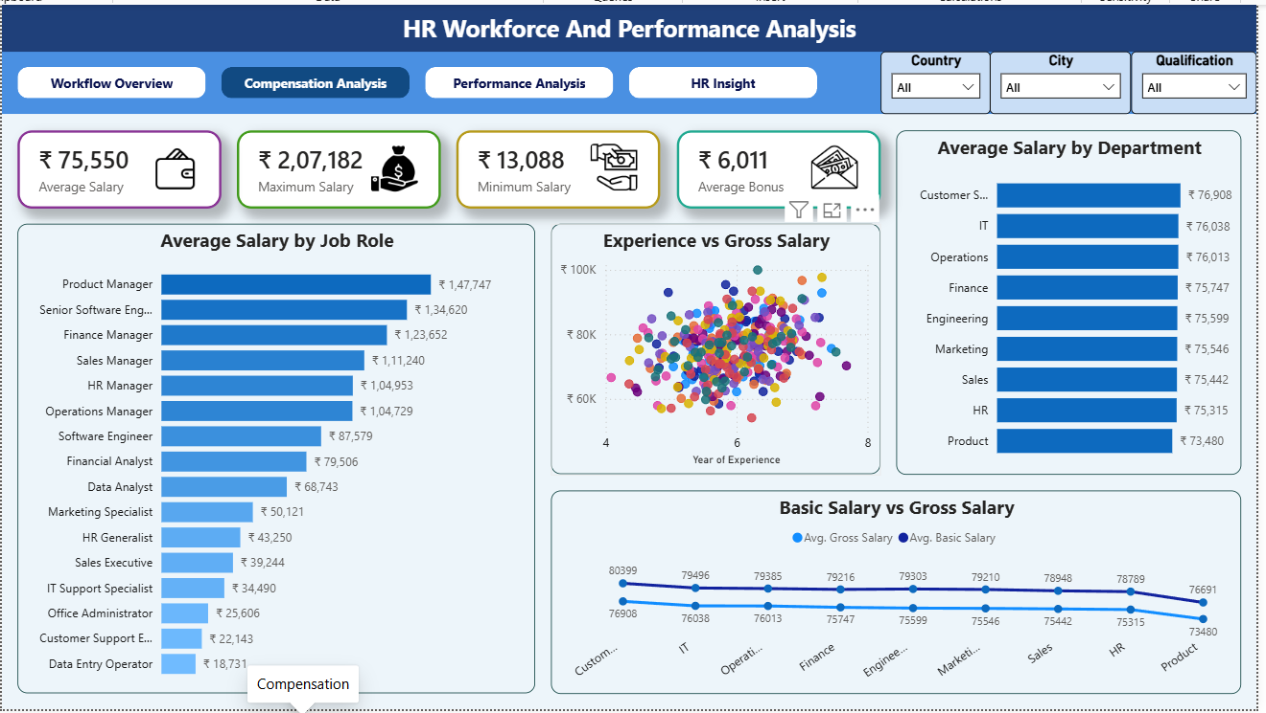
DASHBOARD REVIEW
Compensation Analysis
How are salaries and bonuses distributed across roles and departments?
Key observations
• Average salary shown: ₹75,550; maximum: ₹2,07,182; minimum: ₹13,088.
• Average bonus shown: ₹6,011.
• Product Manager has the highest displayed average salary by job role (₹1,47,747).
• Data Entry Operator has the lowest displayed average salary by job role (₹18,731).
• Customer Service has the highest displayed department average (₹76,908); Product is lowest (₹73,480).
• The experience-versus-gross-salary scatter shows wide variation; experience alone does not determine salary.
INTERPRETATION
Salary comparisons are descriptive. Role seniority, job level, location, currency consistency, and salary components should be considered before drawing fairness conclusions.
HR Workforce And Performance Analysis • Somenath Sau
7

Slide 8
FINDINGS
Compensation - Interpretation & Review Areas
Use role and department comparisons to prioritize investigation, not to make automatic pay decisions
Role-level variation
Department-level variation
Experience relationship
Average salary differs substantially by job role. The highest and lowest role averages may reflect differences in job responsibilities or seniority.
Department averages are relatively close compared with the range across roles. The observed gap should be examined with role mix and grade structure.
The scatterplot has considerable spread at similar experience levels. Consider role, grade, performance, location, and tenure before interpreting the relationship.
Recommended compensation checks
• Confirm the intended currency unit in the source documentation; the supplied CSV files contain numeric salary fields but no currency column.
• Check salary outliers and verify whether maximum/minimum values are valid or data-entry errors.
• Compare salaries within similar job roles or job grades rather than only comparing department averages.
• Review gross salary, basic salary, and bonus definitions to ensure measures are not being mixed.
• Use median and distribution charts alongside averages, because averages can be influenced by extreme values.
Caution
The minimum and maximum values are useful for quality checks but should not be interpreted as fair-pay evidence on their own.
HR Workforce And Performance Analysis • Somenath Sau
8

Slide 9
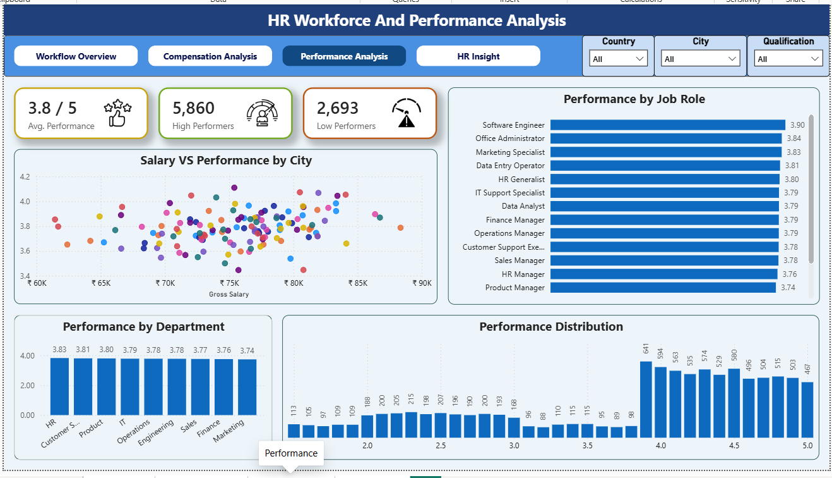
DASHBOARD REVIEW
Performance Analysis
How do performance ratings vary across departments and roles?
Key observations
• Average performance is 3.8 out of 5.
• The KPI cards show 5,860 high performers and 2,693 low performers under the project's current definitions.
• Software Engineer has the highest displayed average rating by role (3.90).
• Marketing has the lowest displayed department average rating (3.74); HR is highest at 3.83.
• The salary-versus-performance scatter shows many ratings clustered around roughly 3.6–4.0 across a range of salaries.
• The source contains fractional performance ratings from 1.5 to 5.0; the distribution chart reflects these values.
INTERPRETATION
The differences between department averages are small in the displayed chart. Check sample sizes and rating definitions before treating small differences as meaningful.
HR Workforce And Performance Analysis • Somenath Sau
9

Slide 10
FINDINGS
Performance - Interpretation & Review Areas
Ratings can identify where to ask questions, but do not independently explain performance
Overall performance
Department differences
Salary and ratings
An average of 3.8/5 suggests ratings are concentrated above the midpoint in this dataset. Confirm the scale and rating process.
Displayed averages range from 3.74 to 3.83. The narrow range calls for cautious interpretation rather than strong rankings.
The scatterplot does not show a simple one-to-one relationship. Salary and performance may be influenced by other factors.
Validation and follow-up
• The supplied performance-rating values range from 1.5 to 5.0; confirm the intended rating policy if fractional ratings need interpretation.
• Validate how high and low performers are defined; the current dashboard appears to use rating thresholds.
• Use rating distribution and group sizes, not only average ratings.
• Consider role-specific performance expectations and manager calibration before comparing teams.
• Combine performance ratings with goals, review period, tenure, and other context where available.
Caution
Do not infer that a department or employee is better or worse based only on a small difference in average rating.
HR Workforce And Performance Analysis • Somenath Sau
10

Slide 11
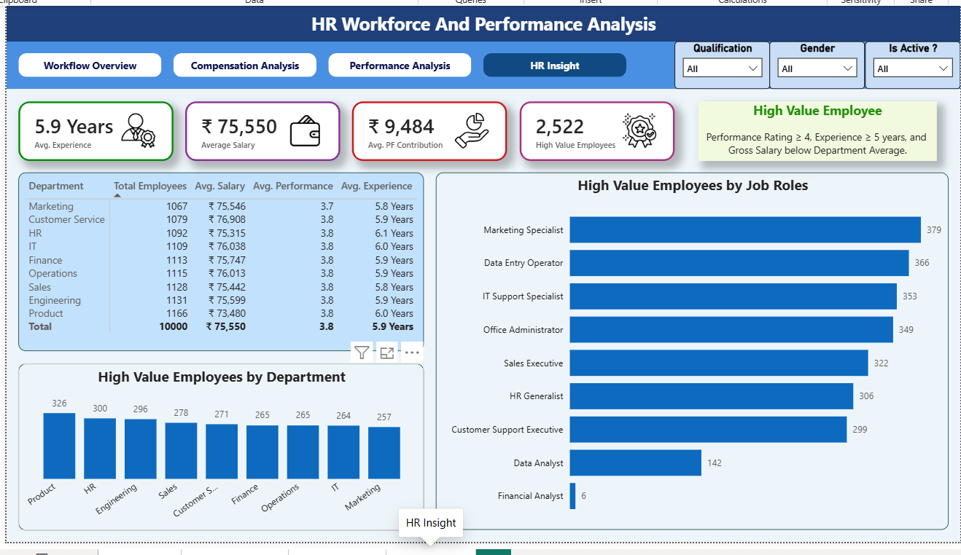
DASHBOARD REVIEW
HR Insight
Which departments and roles contain the largest counts of project-defined high-value employees?
Key observations
• Average experience: 5.9 years; average salary: ₹75,550; average PF contribution: ₹9,484.
• 2,522 employees meet the project's high-value definition.
• Definition used: performance rating ≥ 4, experience ≥ 5 years, and gross salary below department average.
• Product has the highest displayed high-value count by department (326); Marketing has the lowest (257).
• Marketing Specialist has the highest displayed count by role (379), followed by Data Entry Operator (366) and IT Support Specialist (353).
• The definition is a project-created analytical rule, not a standard HR classification.
INTERPRETATION
Treat this segment as a starting point for retention and career-development review. Validate the criteria with HR context before making employee-level decisions.
HR Workforce And Performance Analysis • Somenath Sau
11

Slide 12
METHOD
High-Value Employee Definition & Limitations
A transparent rule makes the segmentation reproducible and easier to challenge
Project definition
Why this definition was used
High Value Employee = Performance Rating ≥ 4 AND Experience ≥ 5 years AND Gross Salary below the average salary of the employee's department.
It combines performance, experience, and relative salary position to create a segment for exploratory review. It is an analytical segmentation used to prioritize further review.
Limitations to disclose
• A salary below department average does not automatically mean underpayment; role and grade matter.
• High performance and experience do not alone prove retention risk or future business contribution.
• The thresholds of rating ≥ 4 and experience ≥ 5 years are the defined analytical criteria for this report.
• The counts may change when slicers or filters are applied in Power BI.
• Employee-level decisions should never be made from this rule without additional evidence and appropriate review.
HR Workforce And Performance Analysis • Somenath Sau
12

Slide 13
FINDINGS
Department HR Scorecard
A compact view of headcount, salary, performance, and experience
Department | Employees | Avg. Salary | Avg. Performance | Avg. Experience
Marketing | 1,067 | ₹75,546 | 3.7 | 5.8 years
Customer Service | 1,079 | ₹76,908 | 3.8 | 5.9 years
HR | 1,092 | ₹75,315 | 3.8 | 6.1 years
IT | 1,109 | ₹76,038 | 3.8 | 6.0 years
Finance | 1,113 | ₹75,747 | 3.8 | 5.9 years
Operations | 1,115 | ₹76,013 | 3.8 | 5.9 years
Sales | 1,128 | ₹75,442 | 3.8 | 5.8 years
Engineering | 1,131 | ₹75,599 | 3.8 | 5.9 years
Product | 1,166 | ₹73,480 | 3.8 | 6.0 years
TOTAL / OVERALL | 10,000 | ₹75,550 | 3.8 | 5.9 years
HR Workforce And Performance Analysis • Somenath Sau
13

Slide 14
NEXT STEPS
Recommendations & Action Plan
Practical follow-up actions grounded in the current analysis
1. Validate data definitions
Confirm active/inactive status, rating scale, salary currency, salary components, and hire-date conventions.
2. Investigate compensation variation
Compare employees within equivalent roles and grades; check valid outliers and salary distributions.
3. Review performance patterns
Check rating calibration, group sizes, role expectations, and the small differences between department averages.
4. Explore the high-value segment
Review whether the criteria are appropriate; combine with engagement, promotion, and attrition information if available.
5. Turn insights into action
Agree on owners, business questions, review cadence, and follow-up measures with relevant HR stakeholders.
HR Workforce And Performance Analysis • Somenath Sau
14

Slide 15
CLOSING
Conclusion & Limitations
The report establishes a baseline and highlights where deeper HR analysis may help
What this report delivers
What it does not establish
A four-page Power BI view of workforce composition, compensation, performance, and an explicitly defined high-value employee segment.
It does not prove causes of salary differences, explain why hiring changes, establish attrition drivers, or validate the high-value rule.
Final message
The analysis is most useful as a starting point for targeted questions. Use the findings alongside workforce policies, role context, and business priorities to guide focused HR actions.
Thank you
HR Workforce And Performance Analysis
HR Workforce And Performance Analysis • Somenath Sau
15

